Slide 1
Net benefit (follow up)
31st January, 2022

Slide 2
Paper 1 –net benefit
Steyerberg EW, Vickers AJ, Cook NR, et al. Assessing the performance of prediction models: a framework for traditional and novel measures. Epidemiology. 2010;21(1):128-138. doi:10.1097/EDE.0b013e3181c30fb2
Goal:
Provide extensions to Vickers and Elkin’s 2007 paper introducing net benefit and decision curve analysis

Slide 3
Extensions
Correction for overfitting
Confidence intervals
Survival outcome
Outcome or predictor unknown
Only predicted probabilities are known

Slide 4
Overfitting
2- or 10-fold cross-validation
Fit model to training set and determine predicted probabilities in the corresponding testing set
Compute net benefit given the threshold probability
Obtain corrected net benefit as the average across 200 iterations

Slide 5
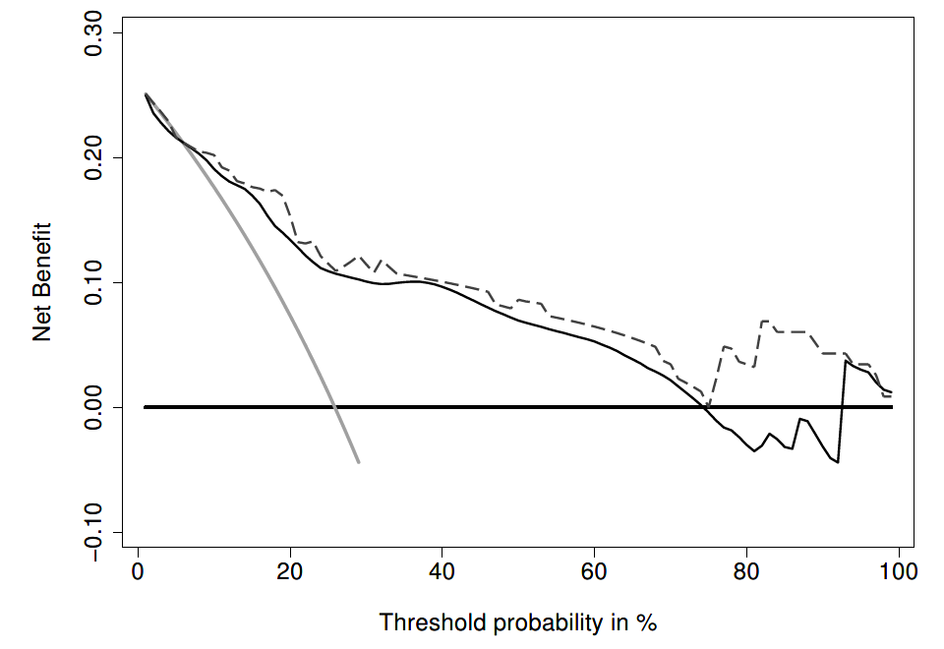
Correction by cross-validation (10-fold)
model
model (corrected)
for all
for none

Slide 6
Overfitting
Bootstrap
Fit model and determine predicted probabilities for bootstrap sample and original data
Calculate the difference in net benefit for a given threshold
Determine the average difference over 200 bootstraps -> optimism
corrected net benefit = uncorrected net benefit – optimism

Slide 7
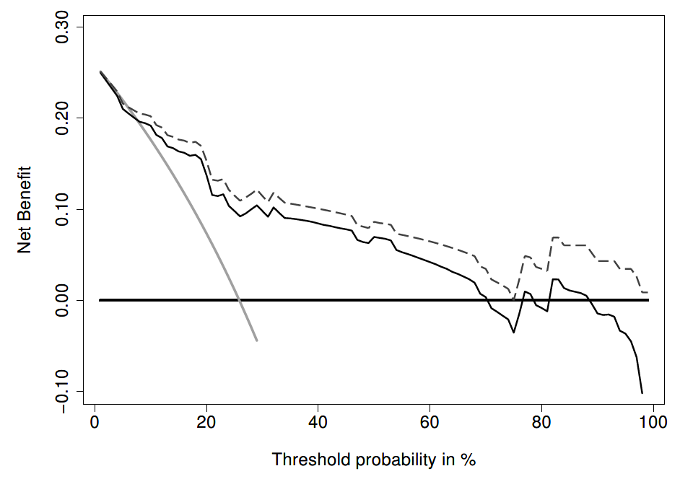
Correction by bootstrap
model
model (corrected)
for all
for none

Slide 8
Overfitting
Conclusions:
Preferred method is 10-fold CV
‘Smoothing effect’
No need to correct for overfitting with sufficient sample size (e.g., > 20 events per predictor)

Slide 9
Confidence intervals
Bootstrap (e.g., n ≥ 1000)
Compute net benefit for each bootstrap sample
Obtain the 2.5th and 97.5th percentiles (at the 95% confidence level)

Slide 10
Survival data
Net benefit calculation requires rate of true and false positives
Set landmark time, t
s(t) = Kaplan Meier survival probability at t
n = total sample size
x = 1 if predicted probability > threshold
# true positives = [1 – (s(t) | x = 1)] * P(x = 1) * n
# false positives = (s(t) | x = 1) * P(x = 1) * n
Non-monotonous to threshold probability
Competing risk (e.g., death)
Use cumulative incidence function, I(t) instead of s(t)

Slide 11
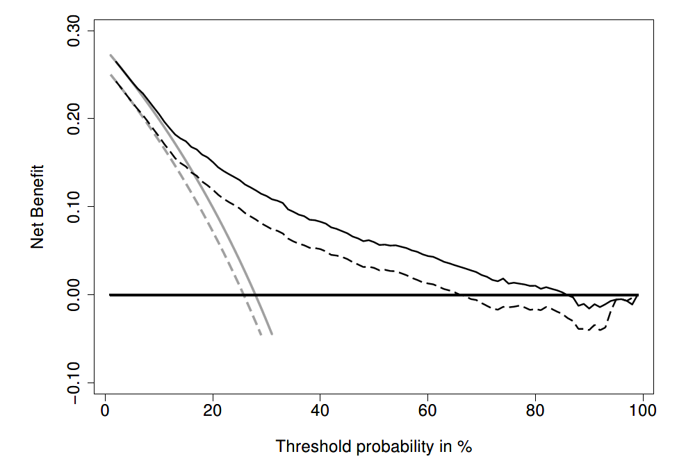
Survival data
dotted line: adjusting for competing risks

Slide 12
Survival data
dotted line: adjusting for competing risks
solid line: no adjustment

Slide 13
Survival data
dotted line: adjusting for competing risks
solid line: no adjustment
gray line: for all men

Slide 14
Survival data
dotted line: adjusting for competing risks
solid line: no adjustment
gray line: for all
black line: according to model

Slide 15
Survival data
dotted line: adjusting for competing risks
solid line: no adjustment
gray line: for all
black line: according to model
Thick black line: for none

Slide 16
Survival data
dotted line: adjusting for competing risks
solid line: no adjustment
gray line: for all
black line: according to model
Thick black line: for none

Slide 17
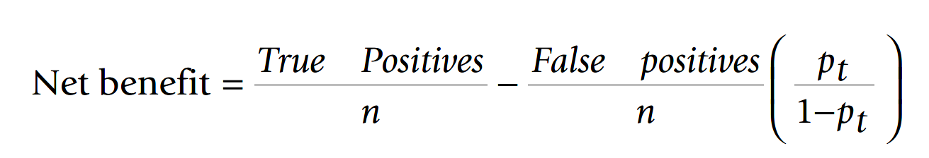
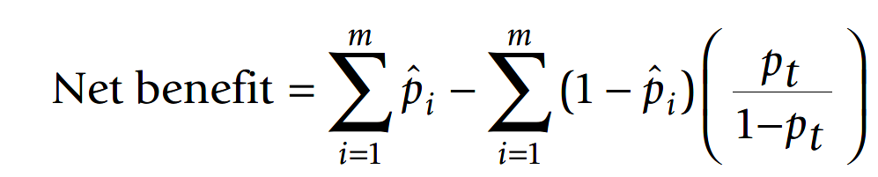
Net benefit with predicted probabilities

Slide 18
Summary
Cross-validation to correct for optimism when small sample is small
Confidence intervals can be estimated with bootstrap
Net benefit extension to survival data
Net benefit extension to when only predicted probabilities are available

Slide 19
Paper 2 – model performance
Steyerberg EW, Vickers AJ, Cook NR, Gerds T, Gonen M, Obuchowski N, Pencina MJ, Kattan MW. Assessing the performance of prediction models: a framework for traditional and novel measures. Epidemiology. 2010 Jan;21(1):128-38. doi: 10.1097/EDE.0b013e3181c30fb2
Goals:
Present classical and novel tools for model performance
Showcase these tools with real data

Slide 20
Example: Testicular cancer
After receiving chemotherapy for testicular cancer, there are potential remnants of tumor tissues.
If there is tumor -> should be removed with resection
If no tumor -> resection is harmful
Logistic regression with 5 predictors
Later extended with new marker (LDH)

Slide 21
Overall measures of performance
Distance between observed data and predictions
R² for continuous data
Nagelkerke’s R² for binary data
Brier score
Scaled Brier score ranging from 0 to 100%
Extension to survival data

Slide 22
Discrimination
How well does the model separate those at high risk and those at low risk
Concordance (c) statistic
Area under the curve of Receiver Operating Characteristic (ROC) curve
Rank order statistic: not sensitive to systematic errors in calibration
Extension to survival data: Gonen and Heller (for Cox PH model only); time-dependent c statistics
Discrimination slope: slope of linear regression of predictions on binary outcome
No extension to survival data

Slide 23
Calibration
Agreement between observed outcomes and predictions
Plot of observations vs. predictions:
Intercept: systematic error
Slope: 1 for a perfect model.
In reality, often smaller than 1 (overfitting)

Slide 24
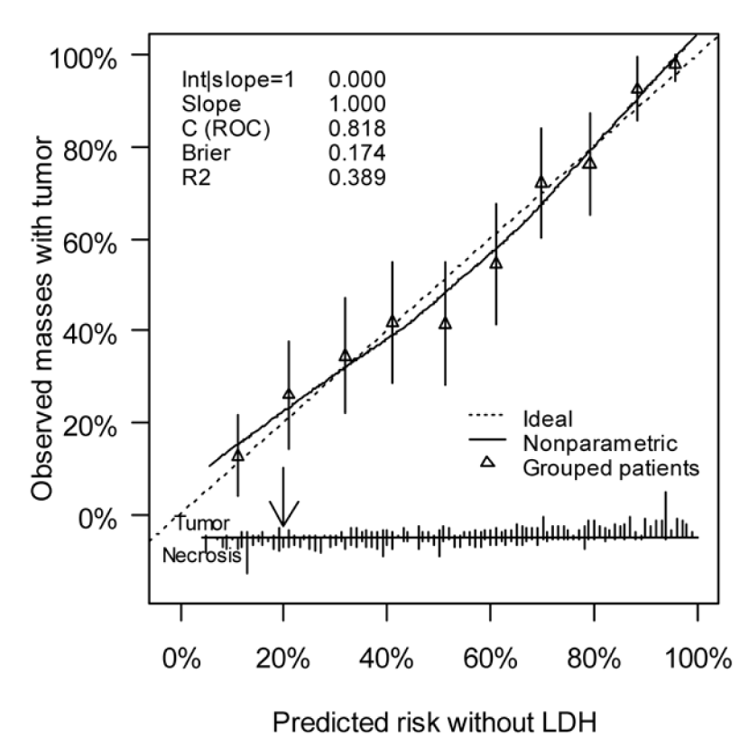
Validation plot
3 in 1 visualization of performance
Calibration plot
Histogram for discrimination
Clinically-relevant threshold

Slide 25
Novel methods
Reclassification table:
How many patients reclassified with new marker
E.g., 30% reclassified with minor improvement in AUC (0.805 to 0.808)
Reclassification test (Cook): variant of goodness of fit test
Net reclassification Improvement (NRI)
Proportion of reclassifications that are the in the right direction
Integrated discrimination improvement (IDI): integrated NRI over all possible thresholds
Related to difference in discrimination slopes or R² or scaled Brier
Decision curve analysis
Threshold probability to weigh benefit and harm
Range of thresholds

Slide 26
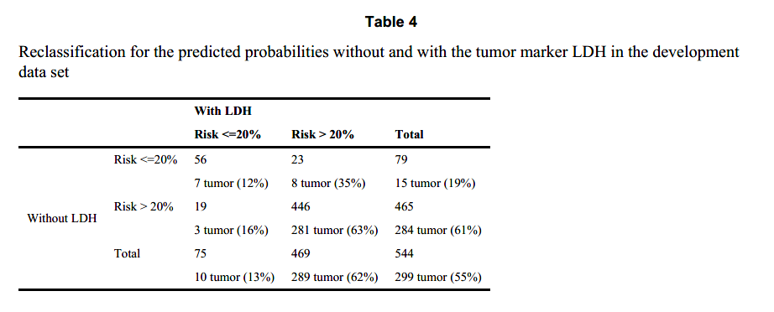
Reclassification

Slide 27
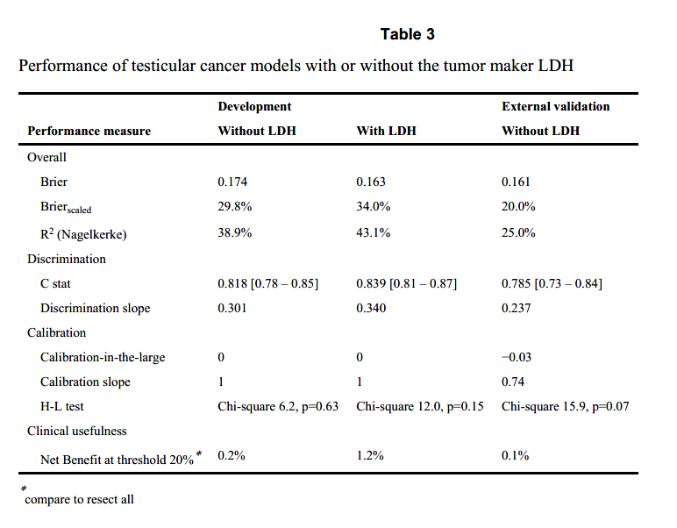
Testicular cancer

Slide 28
Summary
Accuracy:
Goodness of fit
Discrimination
Calibration
Validation plot for visualization
Reclassification
Useful for a well-established single threshold
Clinical usefulness:
net benefit
For a range of threshold probabilities

Slide 29
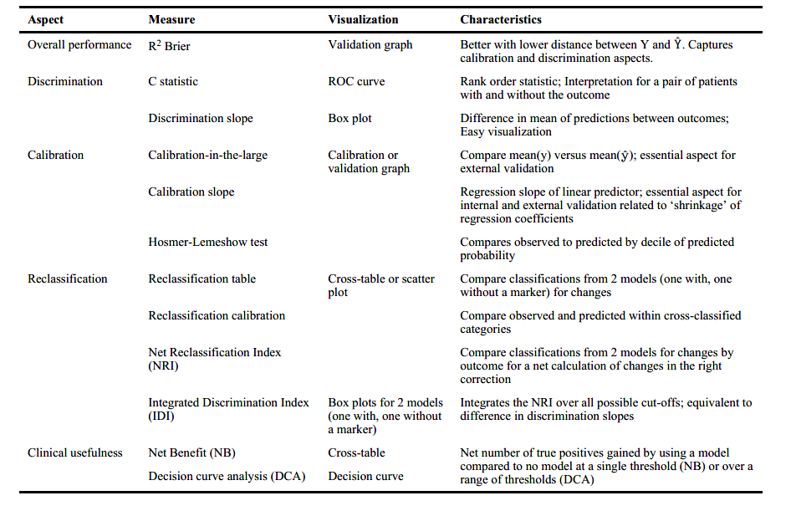

Slide 30
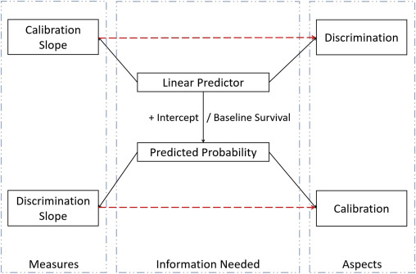
Discrimination slope and calibration slope
“shoes on the wrong feet"
https://www.jclinepi.com/article/S0895-4356(20)30323-1/fulltext

